Slide 1


CHINOOK
MUSIC STORE
Data Analysis and Strategic Recommendations
Tarannum Vaid | 29-06-2024
Chinook
Music Store

Slide 2

CONTENT
01
02
03
04
Introduction
Objectives
Data Overview
Methodological Approach
05
06
07
08
Analyses
Marketing Strategy
Customer Retention
Geographic Expansion

Slide 3




INTRODUCTION
Chinook Music Service, established in 1995, is North Central Washington's leading provider of musical instruments, accessories, and rentals. With a focus on exceptional customer support and a passion for nurturing musical talent, Chinook serves a diverse clientele, from school music programs to rock bands.
Problem Statement: Understanding customer purchasing habits, regional variations, and optimizing promotional strategies is crucial for Chinook to enhance its market presence and better serve its community. This analysis will provide insights into consumer preferences, helping to tailor offerings and promotional efforts effectively.
Chinook
Music Store

Slide 4






OBJECTIVES
Objective nº 1
Objective nº 2
Objective nº 3
Objective nº 4
A thorough analysis of sales trends, gaining a deeper understanding of customer demographics, and identifying potential market opportunities.
Examining seasonal variations, product popularity, and regional differences to refine Chinook’s sales approach.
Identifying market opportunities to enable the company to explore new segments and expand its reach.
Understanding customer demographics to meet diverse marketing needs.

Slide 5
The data includes several key tables, such as Customers, Invoices, and Tracks, which are crucial for analyzing sales performance.
Customers: This table contains detailed information about each customer, including demographic data and location. It helps in understanding customer profiles and preferences, which are essential for targeted marketing.
Invoices: This table records all sales transactions, including invoice dates, total amounts, and customer IDs. It provides a comprehensive view of sales trends over time and is vital for revenue analysis.
Tracks: This table includes details about each track, such as genre, artist, and album. It helps in identifying popular products and trends in customer purchases.
The relationships between these tables allow for in-depth analysis of sales performance. By linking customer data with invoices and track details, we can gain valuable insights into purchasing behavior, product popularity, and regional sales patterns, ultimately informing strategic business decisions.
DATA OVER
VIEW

Slide 6
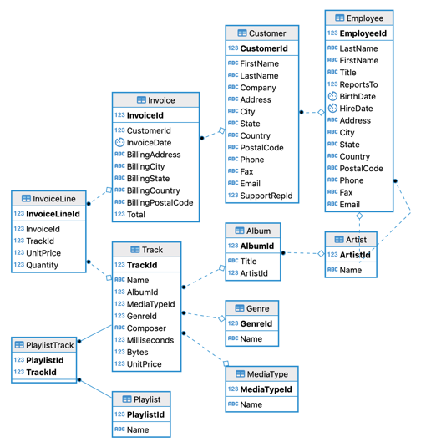
Chinook
Music Store

Slide 7

METHODOLOGICAL APPROACH
The approach to analyzing the data involved using SQL queries to extract, manipulate, and analyze information from the essential tables: Customers, Invoices, and Tracks.
Aggregation methods, such as ‘GROUP BY’, were applied to summarize and aggregate customer data. This helped to calculate statistical information such as average transaction value, total revenue per customer segment, and frequency of purchases. By employing these techniques, trends and patters were identified in customer behaviour and sales performance over time.
Furthermore, statistical analysis helped get customer lifetime value (CLV), retention rates, and purchase frequency to provide deeper insights into customer loyalty and engagement. These insights are helpful in creating marketing strategies to better meet customer preferences and maximize business performance.

Slide 8
Analysis of Questions

Slide 9
OBJECTIVE
QUESTIONS
Chinook
Music Store

Slide 10
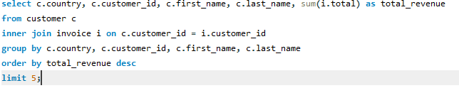
Country-wise top 5 customers by total revenue
Query Explanation:
It combines data from the customer and invoice tables, aggregating total revenue for each customer. The results are grouped by country, customer_id, first_name, and last_name, then ordered in descending order by total_revenue. The LIMIT 5 clause restricts the output to the top 5 highest revenue-generating customers.
Insights:
František Wichterlová leads in the Czech Republic with 144.54 units, followed closely by Helena Holý at 128.70 units.
Luís Gonçalves stands last at top 5 with 108.90 units from Brazil.

Slide 11
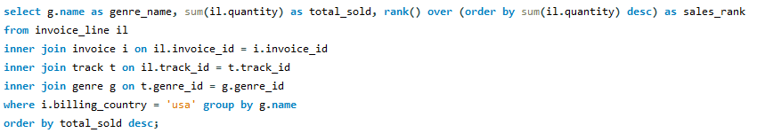
Genres ranked based on their sales performance in the USA
Query Explanation:
This query joins invoice_line, invoice, track, and genre tables to aggregate sales data by genre. The RANK() window function assigns a rank to each genre based on descending total sales (total_sold). Results are grouped by genre_name and ordered by total_sold in descending order to show which genres are the top sellers in the USA.
Insights:
Rock leads in sales with 110 units, indicating strong popularity among USA customers. Metal and Hip Hop/Rap tie for second place with 19 units each, showing similar sales volumes in these genres.
Blues, Classical, Latin, and Jazz each have minimal sales (2, 1, 1, and 1 units respectively), suggesting niche markets within the USA.

Slide 12
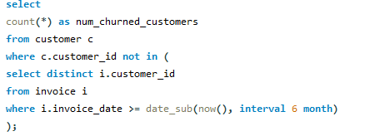
Customer Churn Rate Analysis
For this query, calculations are based on an assumption of 6 months that the customer stopped purchasing. A subquery was used to return distinct customer IDs from invoices dated within the last six months. Then, these active customers were excluded using a `NOT IN` clause in the customer table, and counted those who were not included.
The output, which indicates 59 churned customers, provides a clear extent for understanding customer erosion over a defined period.

Slide 13
SUBJECTIVE
QUESTIONS
Chinook
Music Store

Slide 14
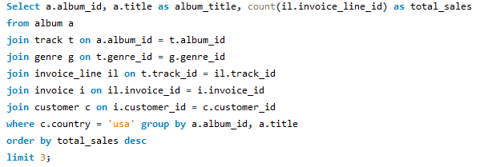
Top Prioritized Albums for Advertising in the USA
Query Explanation:
Determines top-selling genres in each country excluding the USA.
Joins Customer, Invoice, Invoice Line, Track, and Genre tables.
Utilizes ROW_NUMBER() to rank genres by sales volume within each country.
Insights:
Pop and Rock genres dominate sales in most countries.
Classical and Jazz genres stand out in specific regions, suggesting localized preferences.

Slide 15
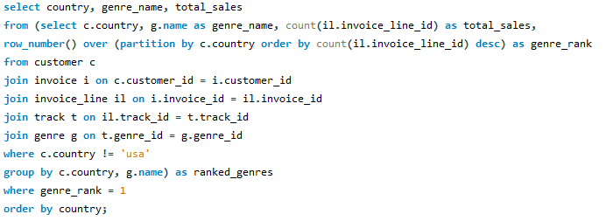
Top-Selling Genres Outside the USA
Query Explanation:
The query aims to identify top-selling albums in the USA based on genre sales.
Joining tables Album, Track, Genre, Invoice Line, Invoice, and Customer to track sales back to albums.
Using COUNT and GROUP BY to aggregate sales per album and sort them in descending order.
Recommendation:
Albums from genres like Rock, and Alternative & Punk, should be prioritized.
These genres show the highest sales volumes in and outside the USA market, indicating strong audience engagement.

Slide 16
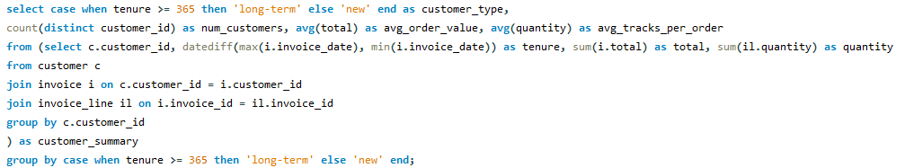
Long-term vs. New Customers' Purchasing Behavior
Query Explanation:
Segments customers based on tenure (long-term vs. new) and analyzes their purchasing habits.
Calculates average order value and tracks per order for each customer segment.
Insights:
Long-term customers spend more per order and purchase more tracks, indicating higher engagement.
New customers show potential for growth with targeted onboarding strategies.

Slide 17
Marketing Strategy
Recommendation: Understanding the preferences of Chinook Music Store’s customer base is crucial for effective marketing. By analyzing sales data, we can identify which genres are most popular among the customers. This insight allows us to tailor improved promotional campaigns to resonate with specific genre preferences.
For example, as Rock genre is the top seller (shown in the visualization below), targeted email campaigns, social media promotions, and in-store displays can feature new releases or special offers in this genre. This personalized approach enhances customer satisfaction and drives higher conversion rates.
Chinook
Music Store

Slide 18

CUSTOMER RETENTION
Recommendation
Recommendation
Visualization
By segmenting customers according to their purchase history and preferences, we can tailor promotional offers and rewards that resonate with each segment, thereby strengthening customer loyalty.
Personalized recommendations based on customers' past purchases and genre preferences can enhance their shopping experience and encourage additional spending.
Total revenue
Total orders

Slide 19
Geographic Expansion
Recommendation: By understanding regional preferences and demographic trends, we can strategically allocate resources for expansion into new markets.
For instance, regions with high average spending per customer or growing populations of music enthusiasts present lucrative opportunities for geographic expansion.
Chinook
Music Store

Slide 20
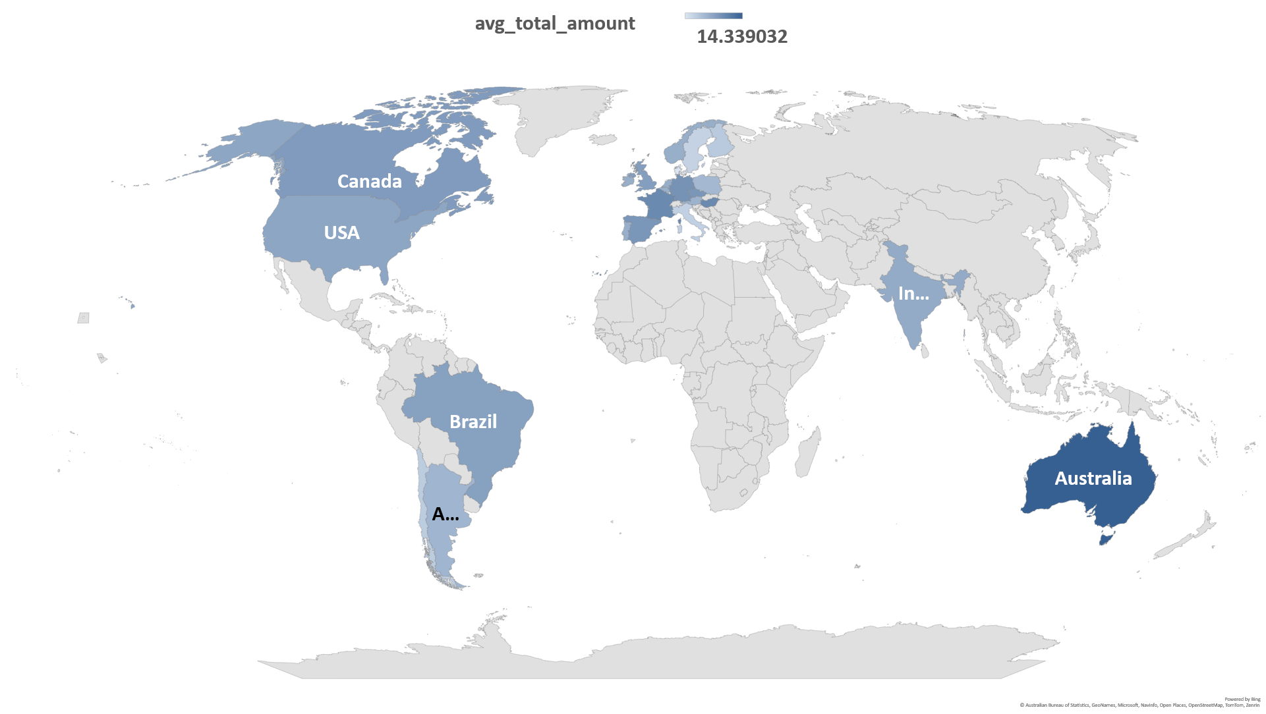

Slide 21


CONCLUSION
The analysis of Chinook Music’s sales data reveals key insights for strategic decision-making: Sales Trends: Dominance of Rock and Pop genres in the USA suggests targeted marketing. Customer Demographics: Diverse customer base across key regions informs tailored marketing strategies. Purchasing Patterns: Insights into customer behavior guide pricing and engagement strategies. Recommendations: Focus on genre-specific marketing, customer retention initiatives, and promoting top-selling tracks to drive growth.
By leveraging these insights, Chinook Music can optimize strategies to meet customer expectations and drive sustainable growth in the competitive music industry.
Chinook
Music Store

Slide 22
THANK
YOU
Chinook
Music Store

